Slide 1
How to Stand Out in a Crowded
Online Fitness Marketplace in 2018
Jill Coleman, MS

Slide 2
What We Are Covering
v
v
Overview of online business
What’s changed over the last 7 years
How people are consuming content
Where are people hanging out online
How to innovate and not have a “me too” business
“Reality show culture”
5 FRESH and RELEVANT tools to separate yourself, stand out and gain traction

Slide 3
Overview of Online Business
v
v
Your Products
1:1 coaching (higher ticket)
Group coaching/mentorship
DIY products
Affiliate marketing
Degree of trust
Numbers
Social media & email marketing
Your Platform
Frameworks/messages
Going from reader/follower to influencer/thinker
Creation > consumption
CCC
Your Unique Ideas
Your passion
Personality/voice
Expertise
Experience/story
Knowables
You

Slide 4
How the Industry Has Been Changing
v
v
Polish + perfection → Transparency and Reality TV
Blogs + white papers → Tweetables, video clips + GIFs
Emails and phone calls → DMs, closed FB groups and texts*
Rest on credentials alone → relatedness, personality, story
Teacher/student → Friends, peers, equality, connection
Fitting yourself in a “success” mold → unapologetic authenticity and innovation
Expertise and mastery of a subject is still important, but now you also have to be accessible and pull back the curtain on who you are as a person

Slide 5
Tool #1: Realness
v
v
Customers/fans/followers are more savvy than ever
Demanding authenticity, personality, polarization
Can’t be faked for Likes and Followers
Too polished feels suspicious*
30s Before + afters, cellulite, messy cars, crying children, junk food, etc.
Still needs to be authencit tho!
People just want to feel validated in their realness = connection
Tool: Master the Pratfall Effect
Relatedness + competency
Accessibility + authority
Humanness + credibility
(Create a body of work!)

Slide 6
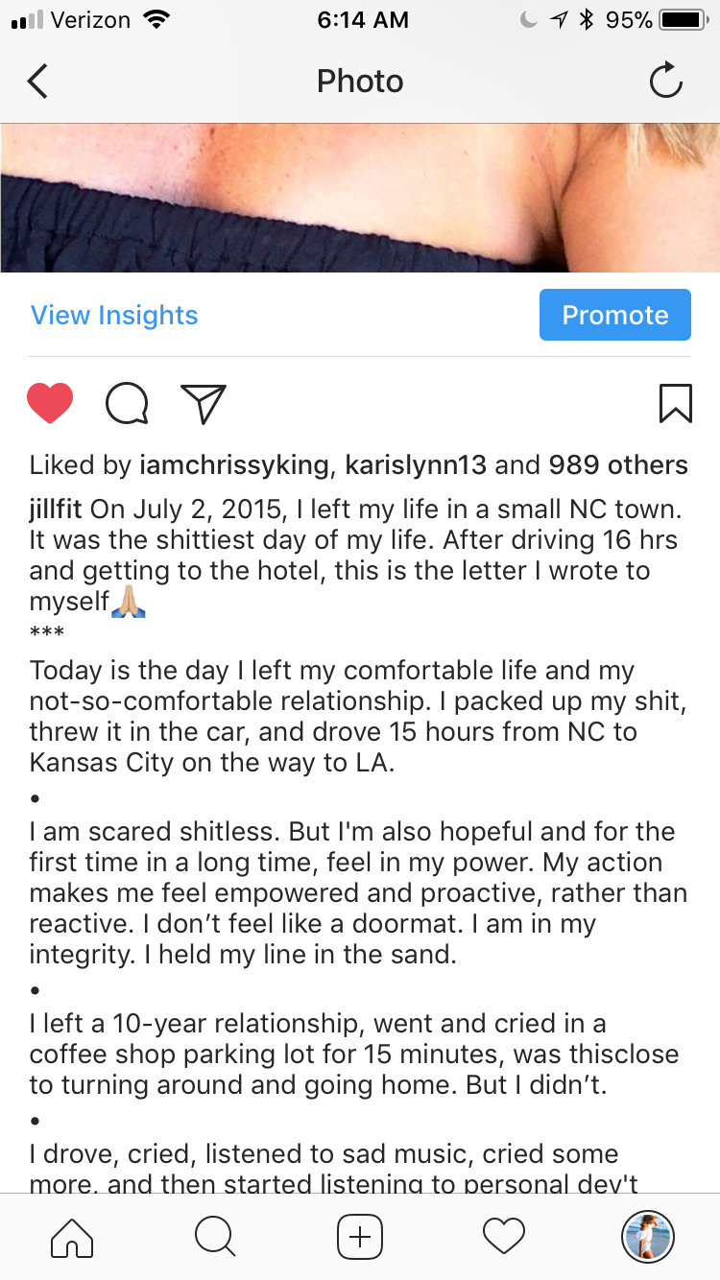
Tool #1: Realness
v
v

Slide 7
Tool #2: Proprietary Concept + Education Around It
v
v
You still have to be an expert in something
3 R’s of Expertise (Brendon Burchard)
Role Model
Results-Getter
Researcher
Understand how people learn: random info versus frameworks and systems
Organize information for people into STICKY concepts
Acronyms, blueprints, frameworks, proprietary words/phrases, HASHTAGS, protocols, catch phrases, rhyming, etc.
Can be completely new OR reengineered concept: #Moderation365, HEC, Rest-based training, MINT Protocol, The 3 S’s to Honest Communcation
And then build an education around it

Slide 8
Proprietary Concept: Example
v
v
#Moderation365 = “How to eat the same on Saturday that you do on Monday”
First, it must solve a problem
All-or-nothing eat trap, food obsession, yo-yo dieting
Now, how to do teach this?
Tools! (You create these!)
Intermittent Sampling
Preemptive cheats
Food FOMO + abundance mindset
Mindfulness - teach this too! Sticky notes, alarms on your phone, etc.
And repeat it over and over and over until your name becomes synonymous with the concept, “Oh, #Moderation365, that’s Jill Coleman”

Slide 9
Tool #3: Transparency Marketing
v
v
Blindsiding people with sales is out!
Long sales pages are out. Traditional internet marketing is out. Trying to trick people into buying stuff is out. Spamming is out.
Asymmetry --> Everyone has all the info
Every step of the marketing process needs to be a win-win for all involved and have innate value
Offer over-the-top value for free
Goal = get people results before any money exchanges hands (trust business, remember?)
Transparency marketing = potential customer knows the sale is coming, you’re not hiding it, in fact you want them to be EXCITED it’s coming!
Positioning sale as a genuine service
Abundance mindset!

Slide 10
Tool #3: Transparency Marketing
v
v
Tool: Beta Testing
Challenges (free)
Sample workouts with feedback requests (free)
Group coaching program, highly discounted or free
Allow for people to experience working with you ahead of the sale
Experience with you builds trust
Get results/value/wins
Feedback to improve it
Social proof*

Slide 11
Tool #4: Video!
v
v
1/3 of all content consumed is video content!
Makes sense given our “Reality Show Culture”
Energy/animation
Accessibility and connection
Way to leverage the power of story
Who are main characters? What are the story lines?
People asking, Is this person more like me, or less? (resonance = trust)
How?
YouTube
FB Live
IG Stories (and Lives)
Snapchat*
Recommend daily stories, weekly Lives, one a month YouTube “day in the life” vids, Q&As, direct to camera, etc.
PEOPLE WANT TO SEE YOUR FACE!

Slide 12
Tool 5: Masterminds + Non-replicable Experiences
v
v
Commodity content is not hard to produce, and it’s vanilla
People will pay for:
Access
Customization
Experiences/face time
Small, tight-knit, elite communities
Network and guest speakers, exclusive resources
Masterminds now versus 2011
How?
Applications
Wait lists
Exclusive invites
Long sales lead times (relationships!)
Amazing opt-in content that gets people results
Small groups - don’t stress about numbers

Slide 13
Tools Recap:
v
v
Tool #1: Realness
Pratfall Effect
Tool #2: Proprietary concept and secondary education
Expertise + innovation + repetition
Tool #3: Transparency Marketing
Beta testing and symmetry of sales process
Tool #4: Video
FB live, YouTube, IG stories (more, more, more!)
Tool #5: Masterminds and high-end experiences
Create exclusivity and elite groups (applications, etc.)

Slide 14
What’s Next?
v
v
Introducing…
Best of You Business Boot Camp: an elite online fitness business membership for health/fitness pros
http://bestofyoucoachingclub.com/info-2018
Cancel-anytime continuity model
New content dropped monthly (3-4 new workshops, expert interviews, etc.)
Teaching you everything from … branding, marketing, sales, program creation, social media, lead generation and email marketing and always ALWAYS the latest tools and strategies!
Closed FB group community
JillFit Business Retreat – September 2018

Slide 15
What’s Next?
v
v
Best of You Business Boot Camp: an elite online fitness business membership for health/fitness pros
http://bestofyoucoachingclub.com/info-2018
Open now through THIS Friday Jan 19th at midnight PST
Two options for enrollment:
$79/mth cancel-anytime
$797 for the year (a full year of business coaching)
BONUS: I’m giving away TEN high-level 1:1 strategy calls for the FIRST 10 people to join for the year!
QUESTIONS?

